Slide 1
VAST Challenge 2018 MC2

Slide 2
Overview
Location: Boonsong Lekagul Wildlife Preserve(BLWP)
Nearby City with Industries: Mistford
Threatened Species: Rose-Crested Blue Pipit bird
Reason for Assumption: Alarmic decrease in Nesting pairs of the bird
Possible culprit: Kasios Office Furniture, a Mistford manufacturing firm
The scenario has changed after the initial investigation: Kasios is convinced that they are innocent. Kasios touts itself as an environmentally friendly company. They have conducted a very public review of the problems brought up the previous year and are claiming wildly different findings

Slide 3
Challenge
Accusation on Kaisos: dumping toxic waste and polluting the air with chemicals from its manufacturing process.
Chemical: Methyolosmolene
What happened: The soil in the suspected dumping site was altered because of recent construction of a Ranger Station in the area.
Professors from Mistford College's Hydrology Department have provided several years of water sensor readings from the preserve's rivers and streams. These samples were gathered from several locations throughout the area and contain measurements of several substances of potential relevance, but they were never tested due to a lack of funds.

Slide 4
DATA
A csv file containing hydrology measurements
A readme file to explain the data fields,
A csv file containing chemical units of measure
Specifies the scale of each sample's unit of measurement
ID | Value | Location | Sample Date | Measure
Measure | Units

Slide 5
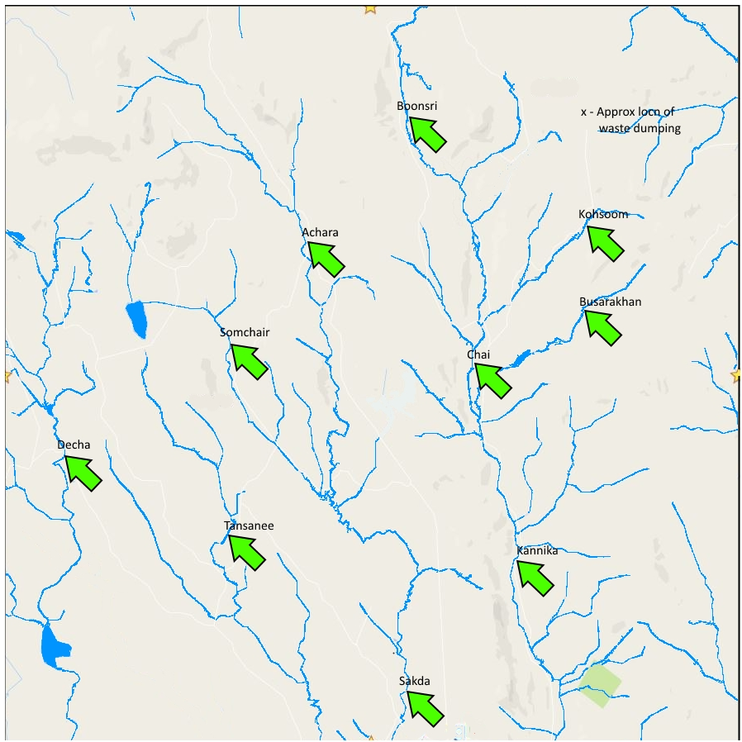
DATA
A map of the BLWP showing 10 sites where hydrology measurements have been made over the years.
Sites:
Achara
Boonsri
Busarakhan
Chai
Decha
Kannika
Kohsoom
Sakda
Somchair
Tansanee

Slide 6
Question 1
Characterize the past and the most recent situation with respect to chemical contamination in the Boonsong Lekagul waterways. Do you see any trends of possible interest in this investigation?

Slide 7
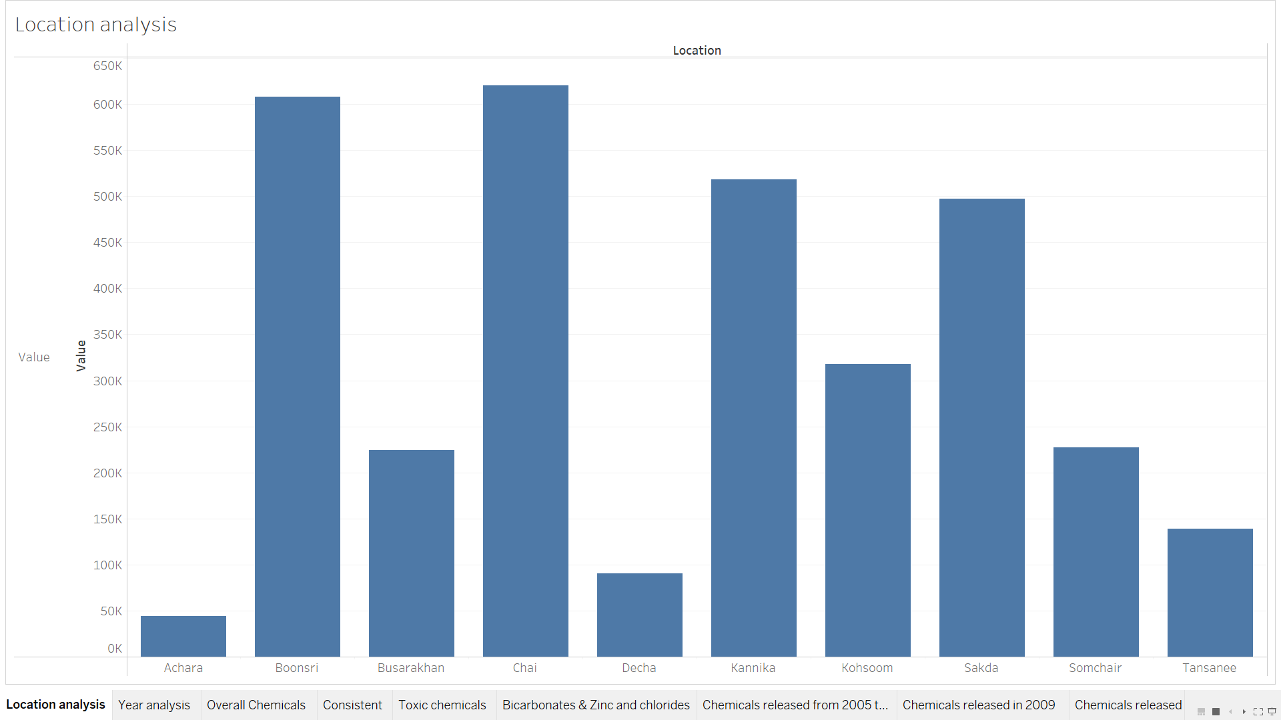
Location Analysis

Slide 8
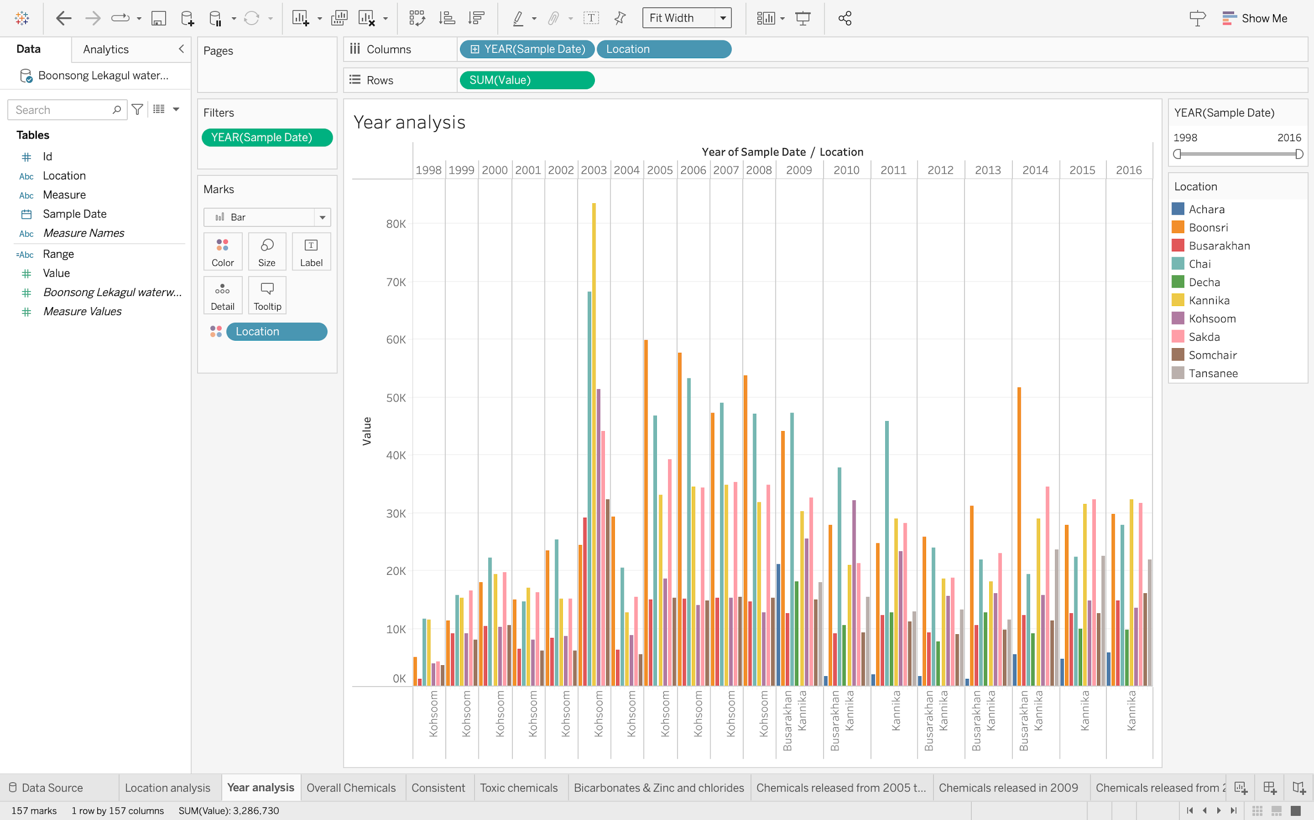
Yearly Analysis

Slide 9
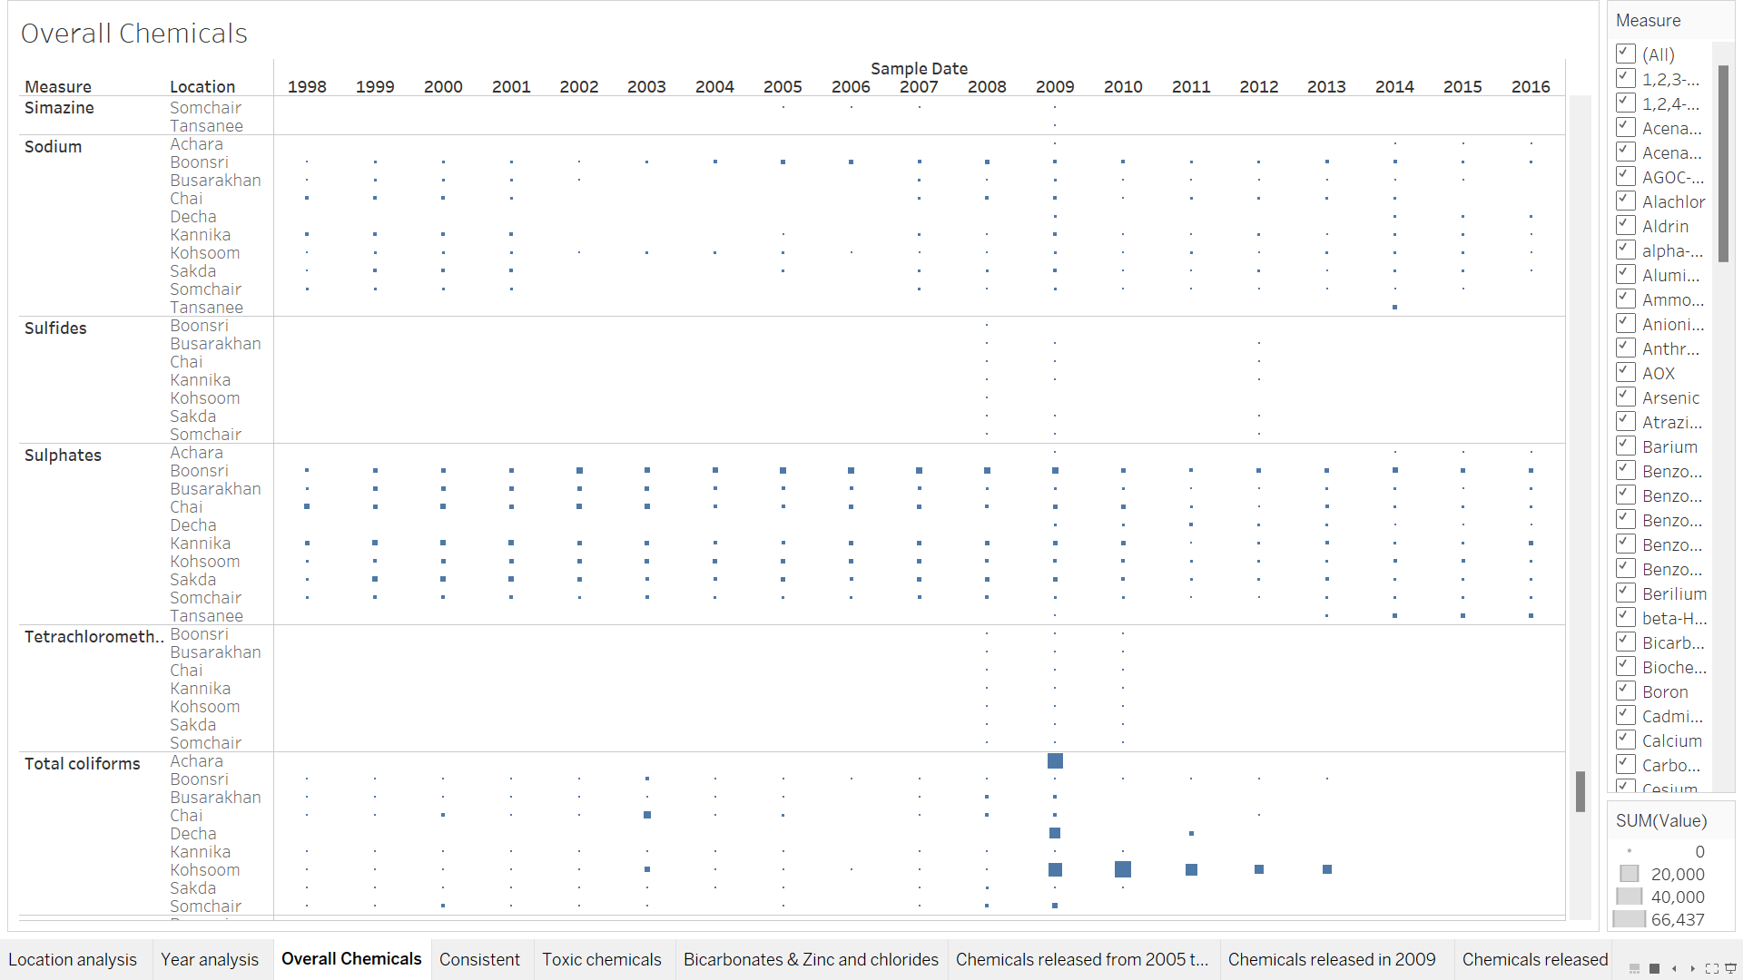
Overall Chemicals

Slide 10
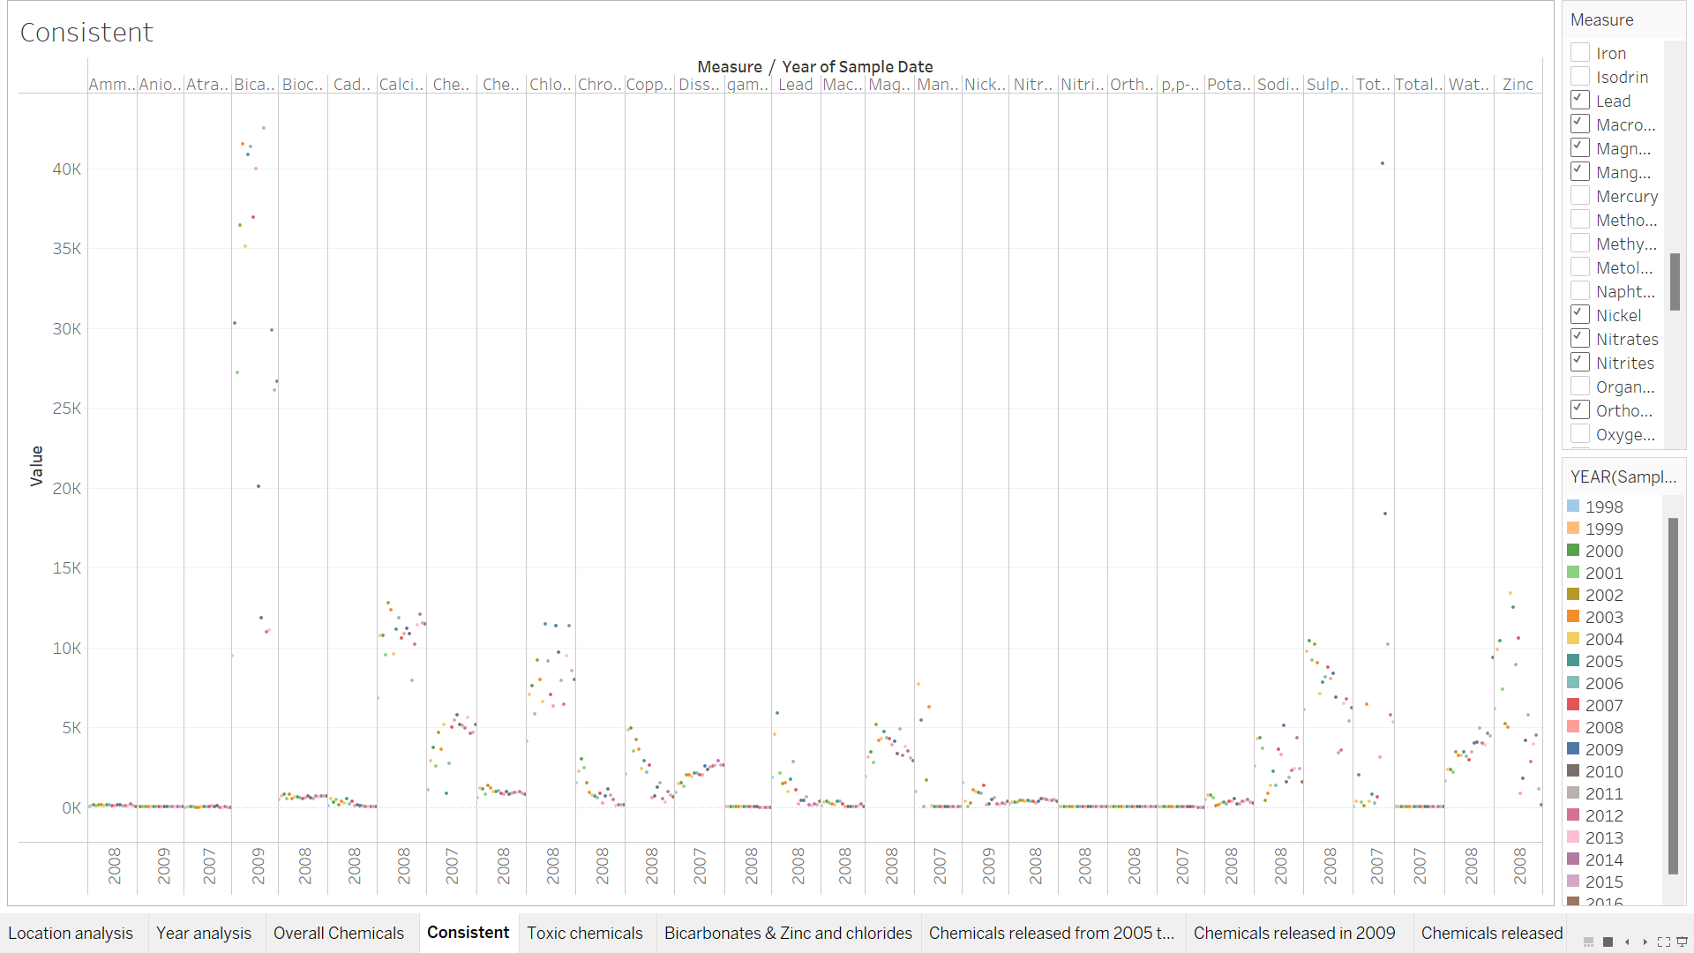
Consistent Chemicals
Ammonium
Atrazine
Bicarbonates
Cadmium
Calcium
Chlorides
Chromium
Copper
Iron
Lead
Magnesium
Manganese
Nickel
Nitrates
Nitrites
Potassium
Sodium
Sulphates
Total Coliforms
Total Dissolved Salts
Zinc

Slide 11
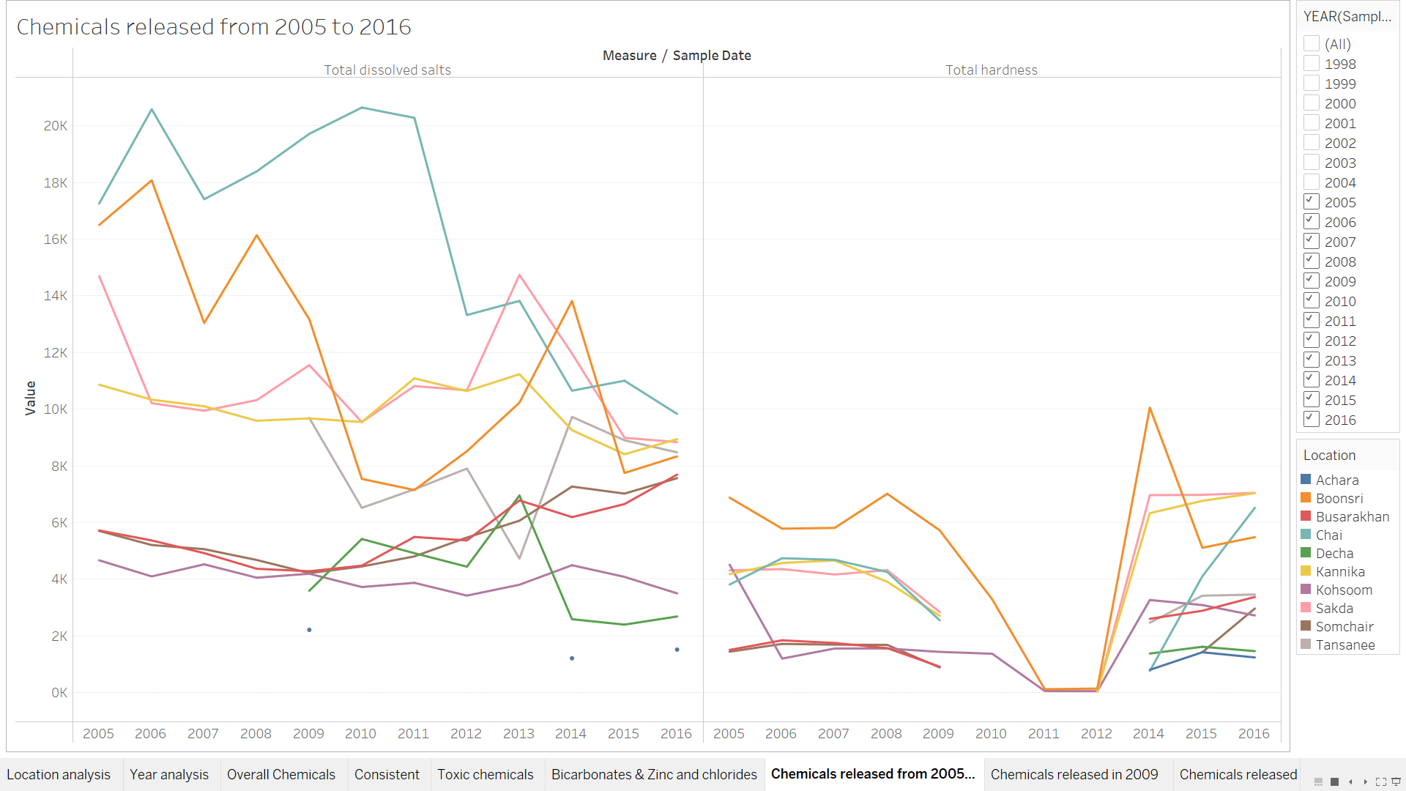
Chemical Trend: 2005 to 2016
Notes:
Tansanee Chai
Decha Kannika
Achara Sakda
Busarakhan

Slide 12
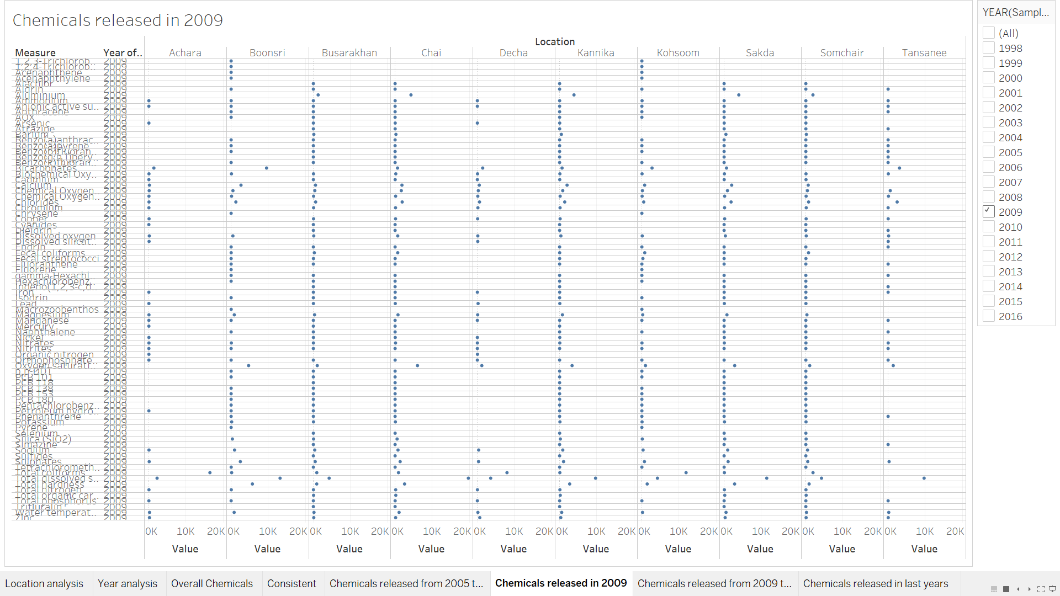
Chemicals in 2009

Slide 13
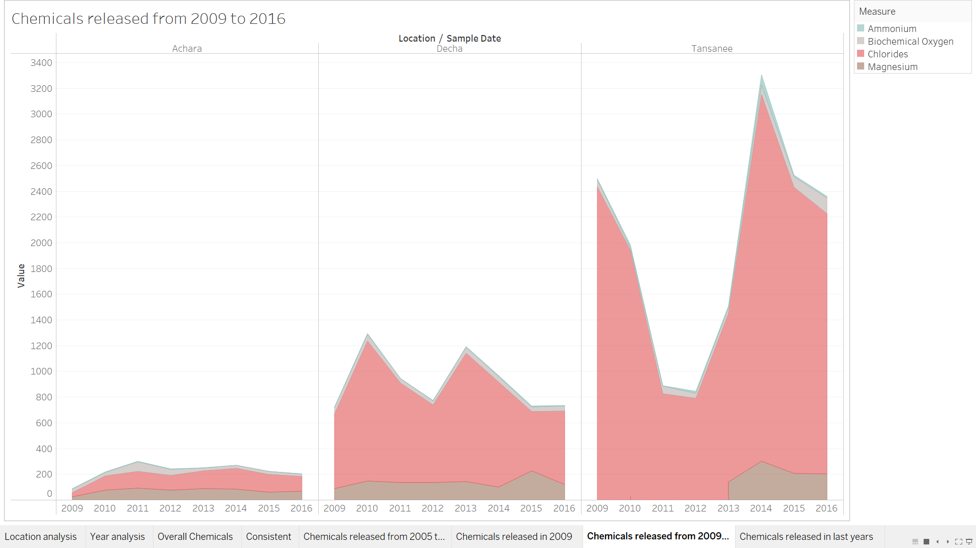
Chemicals from 2009 to 2016

Slide 14
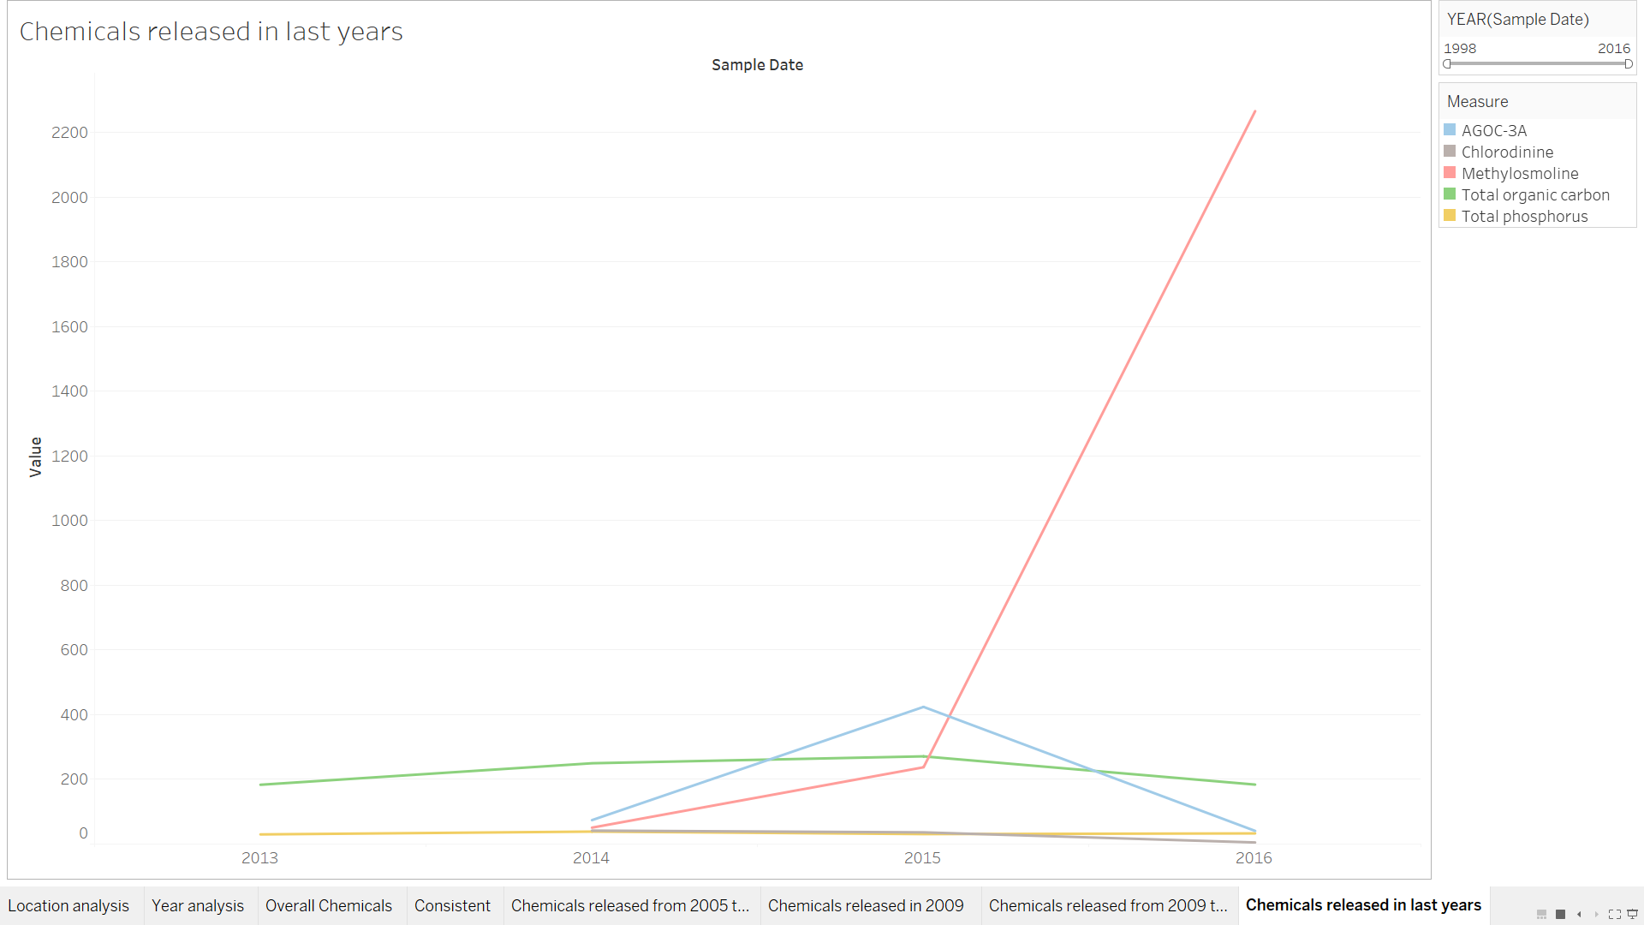
Chemicals released in recent years

Slide 15
Thank You

